Slide 1
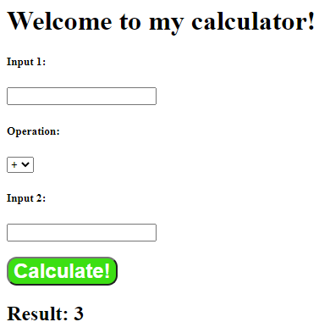
React Calculator Assignment
Requirements:
Create two input fields that can take in numeric values
Create a select (Drop down box) which allows the user to choose what operation to apply to the two numeric fields:
your operations must include addition, subtraction, multiplication, and division.
Output to the user the result of the calculation.
Challenges:
Make it look nice with some CSS!
Protect data input – return a message to the user if the user inputs a non-numeric character.
Have a single input field which can read the operations.

Slide 2
Visual Breakdown: Only one component (Ulrich, 2020)
Create a webpage/container to display:
<h1>: Welcome to my calculator!
<ul>/<li>/<p> element: Result
<form> element to represent a document section containing interactive controls for submitting information (MDN, 2020a).
<input> element: Input 1 and Input 2 input form.
<ul>/<li> element: To display directions/instructions for user.
<select> element: Dropdown box.
<submit> element: To use as submit button (MDN, 2020b).

Slide 3
Visual Breakdown: Only one component (Ulrich, 2020)
Step 1: Take integers from user
Pseudocode:
Display the website.
Wait for user to input numbers in Step 1.
Wait for user to select an operation in Step 2.
When user proceed to Step 3, component is initiated based on the input in a component.
Component will take (Step 1: Input 1) (Step 2: +, -, x, /) (Step 1: Input 2) = (Step 4)
Step 2: Take operations selected by the user
Step 3: onClick event listener to execute the calculator component
Step 4: Display Result

